Slide 1
Registers
Group of storage elements read/written as a unit
  Store related values (e.g. a binary word)
Collection of flip-flops with common control
  Share clock, reset, set lines
Example:
  Storage registers
  Shift registers
  Counters

Slide 2
Storage registers
Basic storage registers use flip-flops
Example: 4 bit storage register

Slide 3
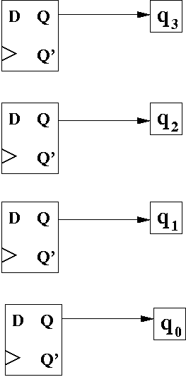

Implementing a 4-bit parallel load register with D flip flops

Slide 4
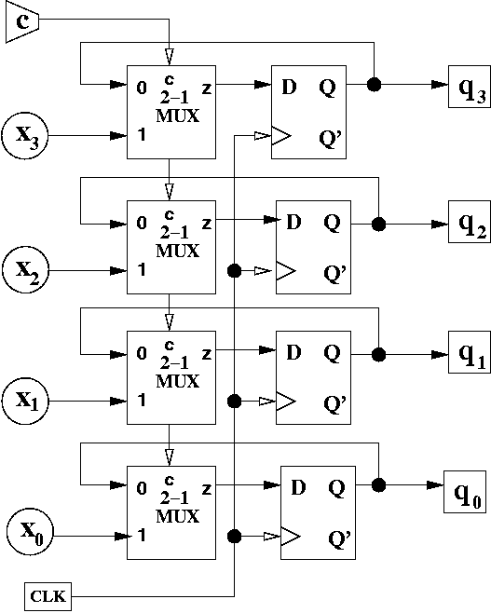
Implementing a 4-bit parallel load register with D flip flops

Slide 5
Shift registers
Hold successively sampled input values
  Delays values in time
  Example: 4-bit shift register
    Stores 4 input values in sequence
OUT1
OUT2
OUT3
OUT4
IN
D
Q
D
Q
D
Q
D
Q
CLK

Slide 6
Counters: Ring counter
Ring counter: Sequence is 1000, 0100, 0010, 0001
  Assuming one of these patterns is the starting state
OUT1
OUT2
OUT3
OUT4
IN
D
Q
D
Q
D
Q
D
Q
CLK

Slide 7
Counters: Johnson counter
Johnson counter: Sequence is 1000, 1100, 1110, 1111, 0111, 0011, 0001, 0000
OUT1
OUT2
OUT3
OUT4
IN
D
Q
D
Q
D
Q
D
Q
CLK

Slide 8
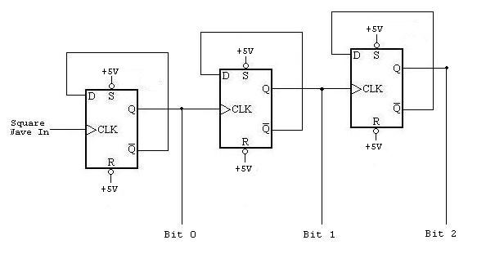
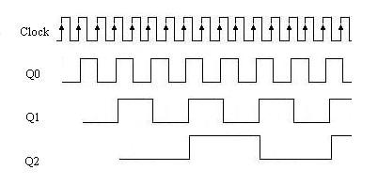
Counters: Ripple counter

Slide 9
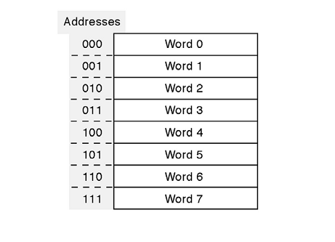
ROM

Slide 10
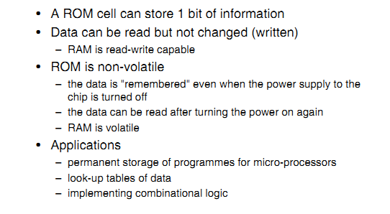
ROM

Slide 11
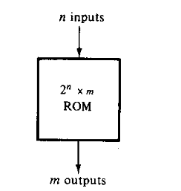
ROM

Slide 12
Function table
A B | F₀ F₁
0 0 | 0 1
0 1 | 0 0
1 0 | 1 0
1 1 | 1 1

Slide 13
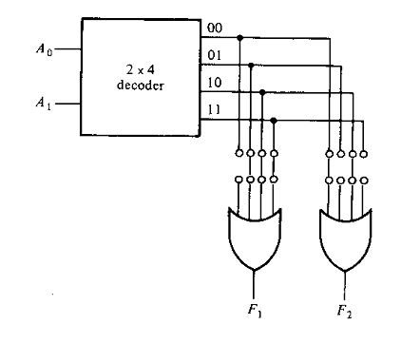
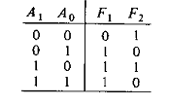
ROM

